Slide 1
MULTIVARIJANTNA I DUBINSKA ANALIZA PODATAKA
ZDRAVSTVENI POKAZATELJI
DIJABETESA
ZDRAVSTVENI POKAZATELJI
DIJABETESA
CDC Diabetes health indicators
Joshua Lee Fletcher, Noa Midžić
Mentorica: Prof. dr. sc. Jasminka Dobša
Fakultet organizacije i informatike
Informacijsko i programsko inženjerstvo 1.4

Slide 2





SADRŽAJ
Dataset i priprema podataka
χ2
Hi-Kvadrat test
Provjera uvjeta za parametarske testove
Wilcoxon rank-sum test
Zaključak

Slide 3
Prikupljeni podaci za različite rizične i druge faktore za dijabetes – kolesterol, fizičko i mentalno zdravlje, pokriće zdravstvenim osiguranjem, ekonomski i socijalni status…
PODACI O DATASETU
PODACI O DATASETU
Behavioral risk factor surveillance system (BRFSS) – godišnja anketa CDC-a preko telefona
70,692 pojedinaca odgovorilo
21 varijabli (podaci su odgovori ili izračunati s obzirom na odgovore)
50% nema dijabetes
Diabetes_binary
0 – nema dijabetes, 1 - ima preddijabetes ili dijabetes

Slide 4
Varijable koje ćemo analizirati
Varijabla | Značenje | Vrsta varijable | Vrijednosti koje poprima
HighChol | Razina kolesterola | Kvalitativna, nominalna | 0 (nizak), 1 (visok)
CholCheck | Pregledan kolesterol u zadnjih 5 godina? | Kvalitativna, nominalna | 0 (jest), 1 (nije)
BMI_Group | Indeks tjelesne mase | Numerička, diskretna | 12-98
HvyAlcoholConsump | Žene >= 7 pića tjedno Muškarci >= 14 pića tjedno | Kvalitativna, nominalna | 0 (ne), 1 (da)
AnyHealthcare | Ima li zdravstveno osiguranje? | Kvalitativna, nominalna | 0 (ne), 1 (da)
NoDocbcCost | U zadnjih godinu dana, nemogućnost odlaska doktoru zbog cijene? | Kvalitativna, nominalna | 0 (ne), 1 (da)
Sex | Spol | Kvalitativna, nominalna | 0 (žena), 1 (muškarac)

Slide 5
Varijable koje ćemo analizirati
Varijabla | Značenje | Vrsta varijable | Vrijednosti koje poprima
Age_Group | AGE5GYR skala dobi: 1 = 18-24, 2 = 25-29, 3 = 30-34, 4 = 35-39, 5 = 40-44, 6 = 45-49, 7 = 50-54, 8 = 55-59, 9 = 60-64, 10 = 65-69, 11 = 70-74, 12 = 75-79, 13 = 80+ godina | Kvalitativna, redoslijedna | 1-13
Education_Group | EDUCA skala obrazovanja: 1 = samo vrtić, 2 = osnovna, 3 = nešto srednje škole, 4 = srednja škola, 5 = fakultet 1-3 godine, 6 = fakultet 4 godine ili više | Kvalitativna, redoslijedna | 1-6
Income | INCOME2 skala zarade: 1 = manje od 10.000 dolara, 2 = 10.000-15.000 dolara, 3 = 15.000-20.000 dolara, 4 = 20.000-25.000, 5 = 25.000-35.000, 6 = 35.000-50.000, 7 = 50.000-75.000, 8 = 75.000 ili više dolara | Kvalitativna, redoslijedna | 1-8

Slide 6
Priprema podataka
Priprema podataka
data = pd.read_csv("diabetes_binary_
5050split_health_indicators_BRFSS2015.csv")
diabetes_0 = data[data['Diabetes_binary'] == 0]
diabetes_1 = data[data['Diabetes_binary'] == 1]
num_per_class = 2000 // 2
selected_0 = diabetes_0.sample(num_per_class)
selected_1 = diabetes_1.sample(num_per_class)
selected_data = pd.concat(
[selected_0, selected_1])
selected_data = selected_data.sample(
frac = 1).reset_index(drop = True)
selected_data.to_csv(
"selected_data.csv", index = False)
diabetes_binary_5050split_health_indicators_BRFSS2015.csv
70.000+ opservacija
Python skripta
Odabir 2.000 opservacija na nasumičan način
50% ispitanika nema dijabetes (0) i 50% ima predijabetes ili dijabetes (1)

Slide 7
Hi-kvadrat testovi na razini signifikantnosti 1%
HighChol – H1
CholCheck – H1
BMI_Group – H1
HvyAlcoholConsump – H1
AnyHealthcare – H0
NoDocbcCost – H0
Sex – H0
Age_Group – H1
Education_Group – H1
Income – H1

Slide 8
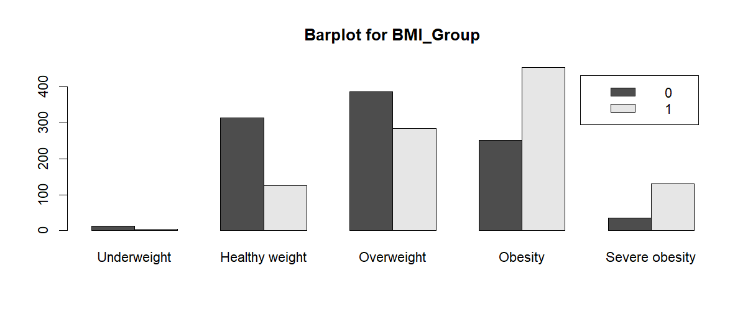
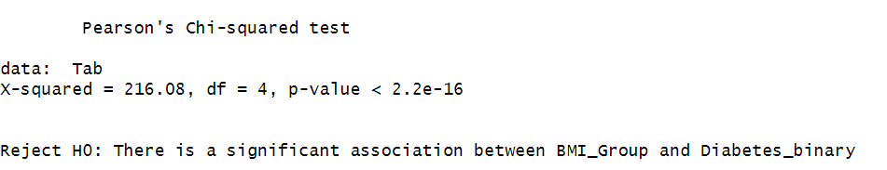
Hi-kvadrat testovi BMI grupe
Grupiranje podataka za primjenu hi-kvadrat testa
data$BMI_Group <- cut(
data$BMI,
breaks = c(
0, 18.5, 24.9,
29.9, 39.9, Inf),
labels = c("Underweight“,
"Healthy weight",
"Overweight",
"Obesity",
"Severe obesity"))
Slika 1. Barplot za BMI grupe

Slide 9
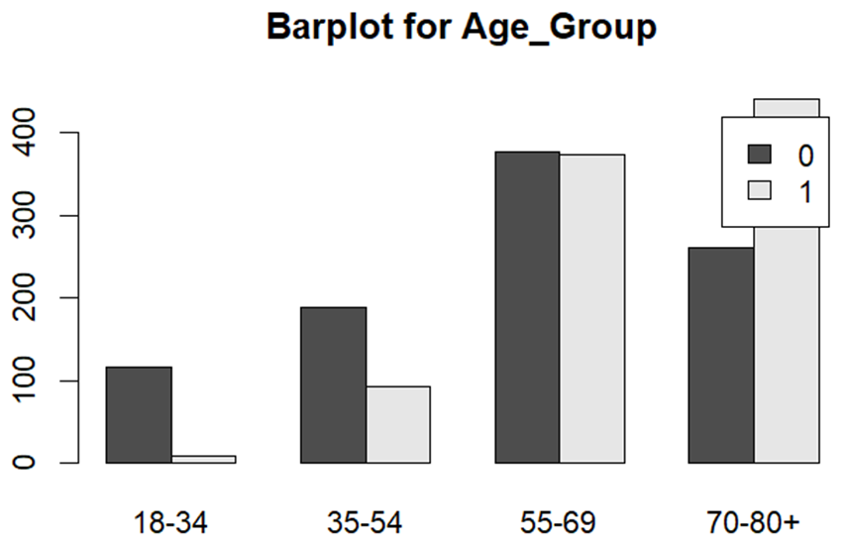
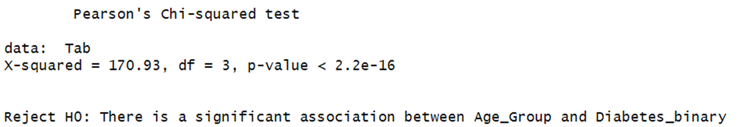
Hi-kvadrat testovi grupe godina
Dataset koristi AGEG5YR (1 = 18-24, 9 = 60-64, 13 = 80+)
data$Age_Group <- cut(
data$Age,
breaks = c(
seq(0, 13, by = 3)),
labels = c(
"18-34", "35-54",
"55-69", "70-80+"))
Slika 2. Barplot za grupe godina

Slide 10
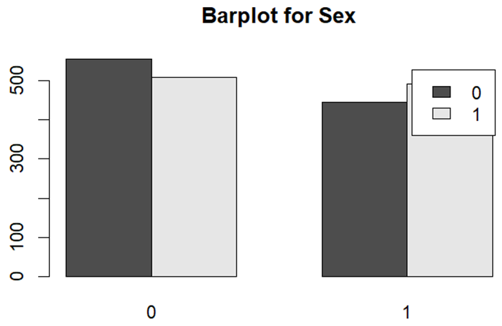
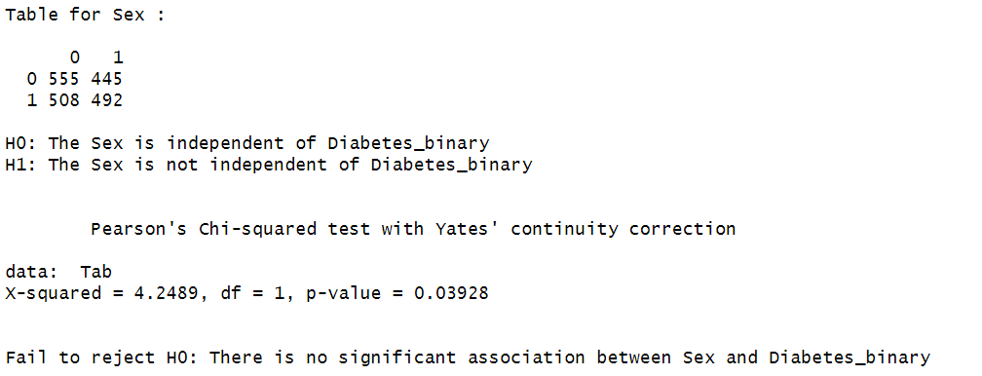
Hi-kvadrat testovi spol
Na razini signifikantnosti 1% - odbačena je nul-hipoteza
Na razini signifikantnosti 5% - muškarci imaju veću tendenciju biti dijabetičari
Slika 3. Barplot za spol

Slide 11
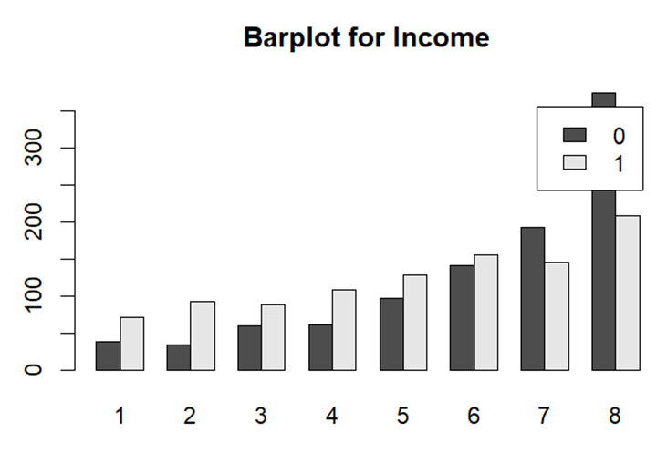
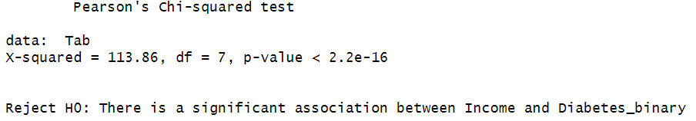
Hi-kvadrat testovi zarada
Slika 3. Barplot za zaradu

Slide 12
Priprema podataka
Priprema podataka
diabetes_binary_5050split_health_indicators_BRFSS2015.csv
70.000+ opservacija
Python skripta
Odabir 2.000 opservacija na nasumičan način
50% ispitanika nema dijabetes (0) i 50% ima predijabetes ili dijabetes (1)

Slide 13

Product overview
First beautifully designed product that's both stylish and functional

Slide 14
Our competition
Our product is priced below that of other companies on the market
Design is simple and easy to use, compared to the complex designs of the competitors
Affordability is the main draw for our consumers to our product
Company A product is more expensive
Companies B & C product is expensive and inconvenient to use
Companies D & E product is affordable, but inconvenient to use

Slide 15
Product overview
Unique
First to market
Tested
Authentic
Only product specifically dedicated to this niche market
First beautifully designed product that's both stylish and functional
Conducted testing with college students in the area
Designed with the help and input of experts in the field

Slide 16

Growth strategy
Feb 20XX: roll out product to high profile or top-level participants to help establish the product
May 20XX: release the product to the public and monitor press release and social media accounts
Oct 20XX: gather feedback and adjust product design as necessary

Slide 17
Market overview
Opportunity to build
Fully inclusive market
Total addressable market
Freedom to invent
Selectively inclusive market
Serviceable available market
 | Clients | Orders | Gross revenue | Net revenue
20XX | 10 | 1100 | $10,000 | $7,000
20XX | 20 | 200 | $20,000 | $16,000
20XX | 30 | 300 | $30,000 | $25,000
20XX | 40 | 400 | $40,000 | $30,000

Slide 18
Product overview
Our product makes consumer lives easier, and no other product on the market offers the same features
Gen Z (18-25 years old)
Reduce expenses for replacement products
Simple design that gives customers the targeted information they need
Close the gap
Target audience
Cost savings
Easy to use

Slide 19
Financials
 | Year 1 | Year 2 | Year 3
Income
Users | 50,000 | 400,000 | 1,600,000
Sales | 500,000 | 4,000,000 | 16,000,000
Average price per sale | 75 | 80 | 90
Revenue @ 15% | 5,625,000 | 48,000,000 | 216,000,000
Gross profit | 5,625,000 | 48,000,000 | 216,000,000

Slide 20
Thank you
Brita Tamm
502-555-0152
brita@firstupconsultants.com
www.firstupconsultants.com

